Slide 1
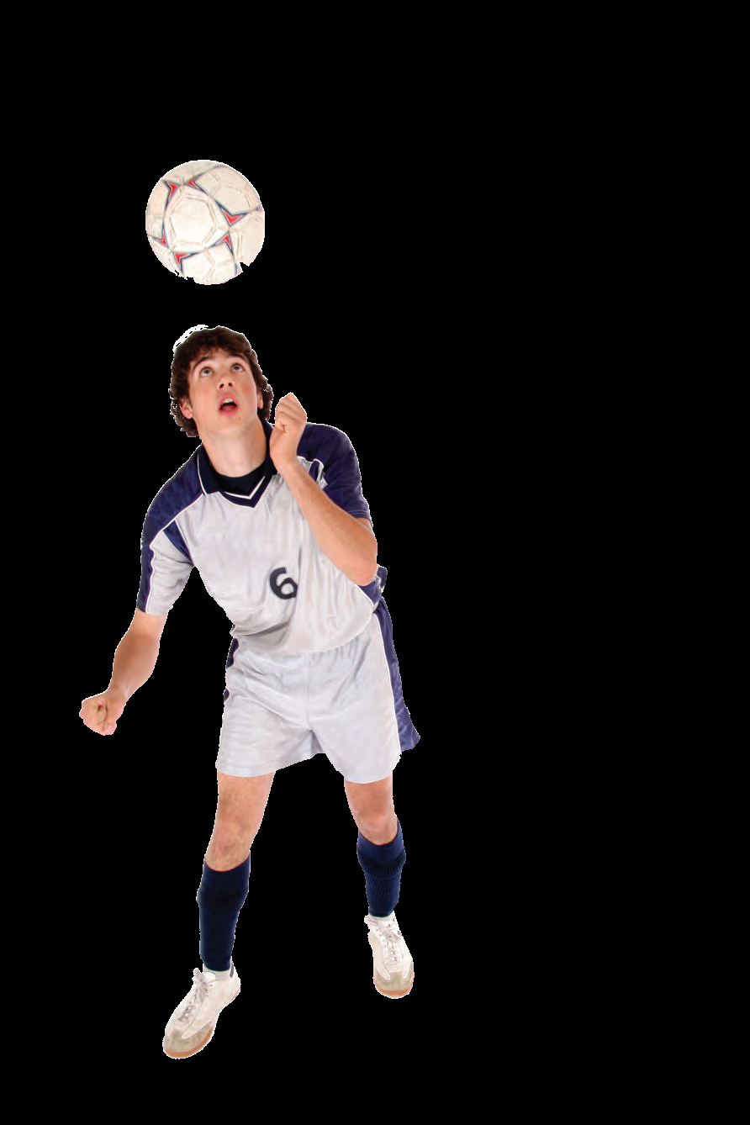
Treatment of Psychological Disorders

Slide 2
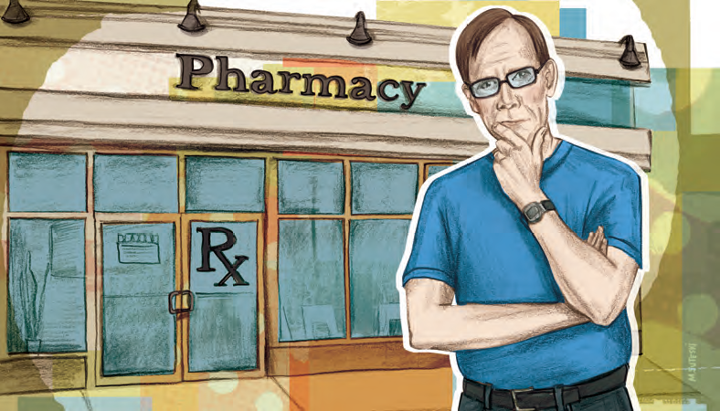
Biomedical Therapies
Module 34

Slide 3
Biomedical Therapies
The treatment of psychological disorders by changing the brain’s functioning by using prescribed drugs, electroconvulsive therapy, or surgery.

Slide 4
Drug Therapies
What do you remember from Psychology 110 and how people with mental illness were treated?
Early Treatment of Mental Disorders (5 min)
Deinstitutionalization Effects (6 min)
Movie
“One Flew Over the Cuckoo’s Nest”
Module 34: Biomedical Therapies

Slide 5
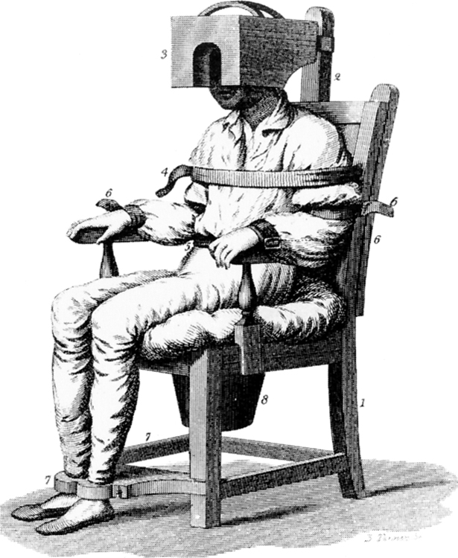
Pre-Drug Therapy
Prior to the discovery of psychological drugs, hospitals had few options with which to treat patients
Most early treatment techniques are today considered archaic and sometimes cruel

Slide 6
Post-Drug Therapy
With the discovery of effective drug treatments, patients were able to leave the institutions (deinstitutionalization).

Slide 7
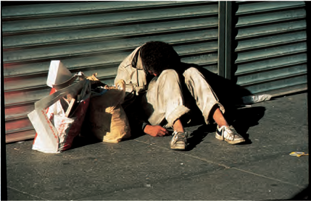
Deinstitutionalization
The release of patients from mental hospitals into the community.
The development of drug therapies led to an 80% decline in the number of hospitalized mental patients from 1950 to 2000.
Many of the former patients became part of the homeless population.

Slide 8
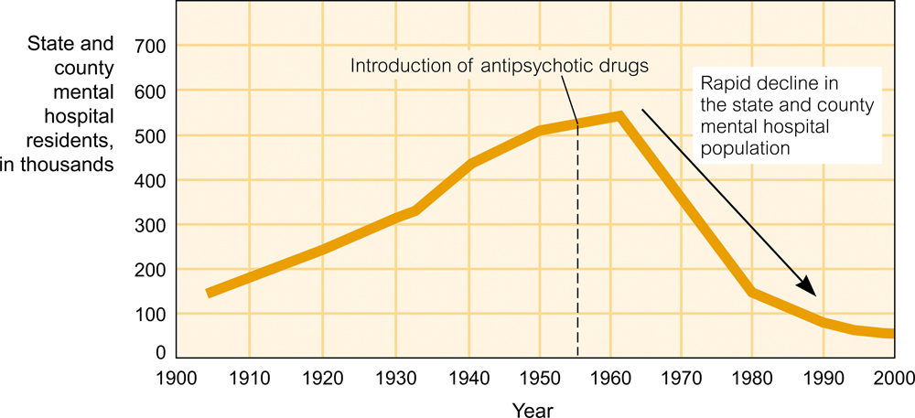
Deinstitutionalization

Slide 9
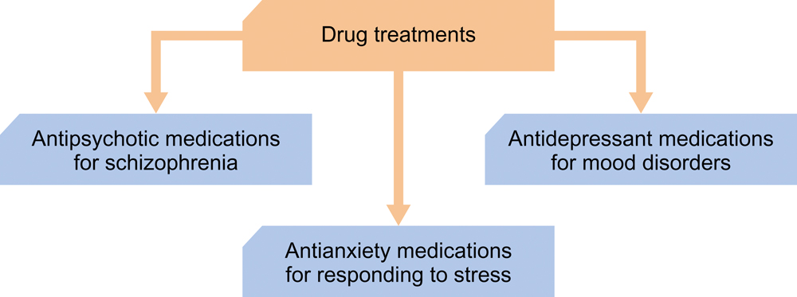
Drug Therapy three main categories that enabled deinstitutionalization

Slide 10
Drug Therapies: like all drugs,they provide both main effects (the desired effects of taking the drug) and side effects (the unintended consequences of taking drugs), some of which are undesirable.
Module 34: Biomedical Therapies

Slide 11

Antipsychotic Drugs
A category of medications used primarily to treat schizophrenia.
Reduces the levels of hallucinations and delusions and distorted thinking
Drugs work by blocking the activity of dopamine

Slide 12
Thorazine
One of the first antipsychotic drugs(dopamine lowering)
Side effects include: dry mouth, blurred vision, constipation, and tardive dyskinesia
Tardive dyskinesia – a permanent condition of muscle tremors

Slide 13
Clozaril
Clozaril: less side effects than thorazine but can cause damage to white blood cells therefore patients need to be tested regularly
Is very expensive.
Considered the most effective treatment for schizophrenia
Why do some people resist in taking their medication and what happens then? (Read in text and take notes)

Slide 14
Drug Therapies:
Antianxiety Drugs
Module 34: Biomedical Therapies

Slide 15
Antianxiety Drugs
A category of medication used to treat people undergoing significant stress;
they can be helpful in treating people with anxiety disorders.
Boosts levels of the neurotransmitter GABA
Can produce dependency
Include: Valium, Librium, and Xanax
Can cause death if mixed with alcohol
Why are antianxiety drugs best used in combination with other forms of psychotherapy? See text p. 611

Slide 16
Antianxiety Drugs cont’d
There aren't any miracle quick-fix cures or “secret remedies or formulas" that eliminate anxiety. There are, however, many methods, medications, herbs, vitamins, and remedies that may help to diminish symptoms, but NONE OF THEM CURE ANXIETY. They may only help reduce symptoms, but even placebos can do that. https://www.anxietycentre.com/anxiety-cures.shtml

Slide 17
Drug Therapies:
Antidepressant Drugs
Module 34: Biomedical Therapies

Slide 18
Antidepressant Drugs
A category of medications used primarily to boost serotonin levels in the brain;
they can be helpful in treating major depression
Prozac, Zoloft and Paxil are common antidepressants and are classified as selective serotonin reuptake inhibitors (SSRI)

Slide 19
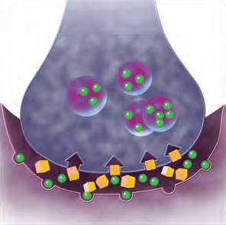
Selective Serotonin Reuptake Inhibitors
Classification of antidepressants which work by blocking the reuptake of serotonin after it has been released
So serotonin remains active in the synapse longer than otherwise.
The use of antidepressants has skyrocketed in the past several years and it is estimated that about 38 million people around the world take them. Why?

Slide 20
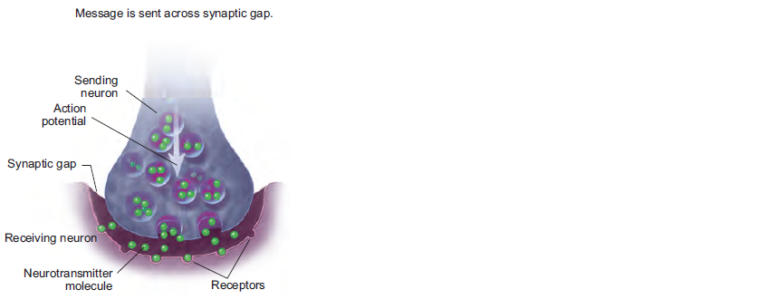
Prozac and the Brain

Slide 21
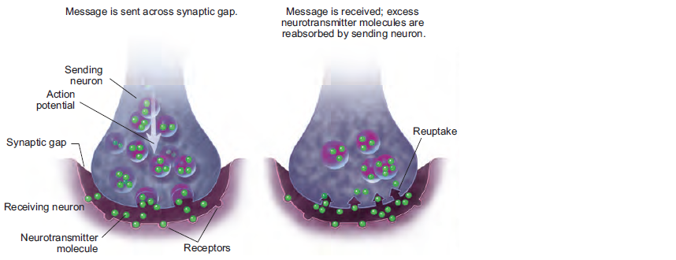
Prozac and the Brain

Slide 22
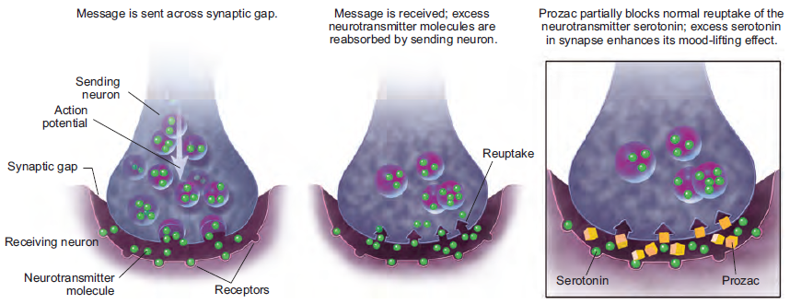
Prozac and the Brain

Slide 23
Antidepressant Drugs
Must be taken for about a month before they become effective (therapeutic lag)
Judging their overall effectiveness is difficult because depression is a cyclical disorder. Depression goes through cycles lifting and deepening over time.
This path makes it difficult to determine whether a medication is working or not.

Slide 24
One recent study combined the effects of almost two dozen carefully conducted studies on depression.
The results?
People given a placebo (pill that has no chemical effect) reported almost as much improvement as people given the real medication
So, the belief that they would feel better had the same effect as the serotonin enhancing drugs.

Slide 25
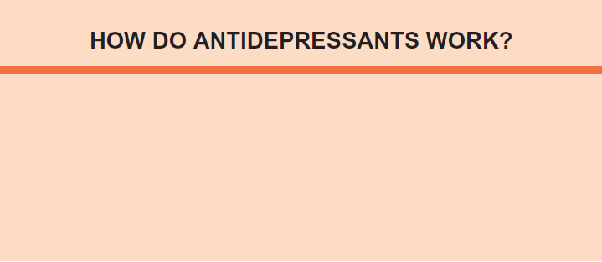
How Do Antidepressants Work?

Slide 26
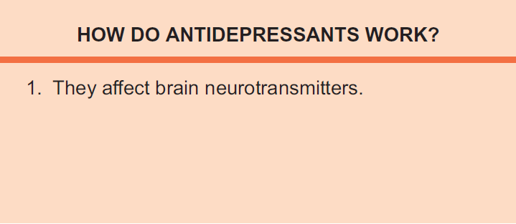

Slide 27
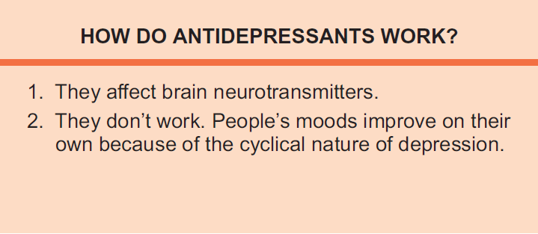

Slide 28
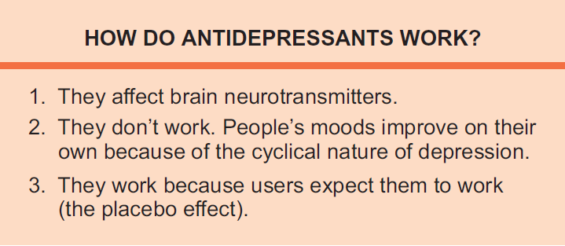

Slide 29
Mood stabilizing Medications
Lithium: Medication used primarily to treat bipolar disorder
Not known how or why lithium works but a large number of bipolar patients report improvement with the drug(70%)
Drugs seem to bring stability and calm to areas of the brain that have become overstimulated/overactive

Slide 30
A different view.....
Medication Spellbinding......

Slide 31
Electroconvulsive Therapy
Module 34: Biomedical Therapies

Slide 32
Insulin Therapy
Depressed patients are given an overdose of insulin to cause a convulsion.
Difficulties in determining the proper dosage of insulin led to a decline in use of this therapy.
Was replaced by Electroconvulsive Therapy (ECT)

Slide 33
Electroconvulsive Therapy (ECT)
Therapy for major depression in which a brief electrical current is sent through the brain of an anesthetized patient.
The current causes a convulsion.
Was preceded by insulin therapy.
Sometimes called “shock therapy.”

Slide 34
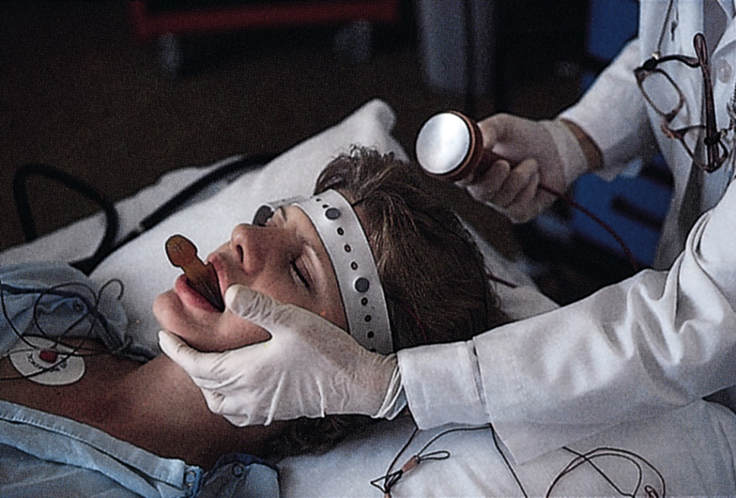
ECT Facts
Used when antidepressants fail
Most (80%) patients report improvement
Side effect is potential memory loss
How and why the process works is unknown

Slide 35
Past vs. Present.....

Slide 36
Electroconvulsive Therapy
Out of Mind ECT
Modern ECT

Slide 37
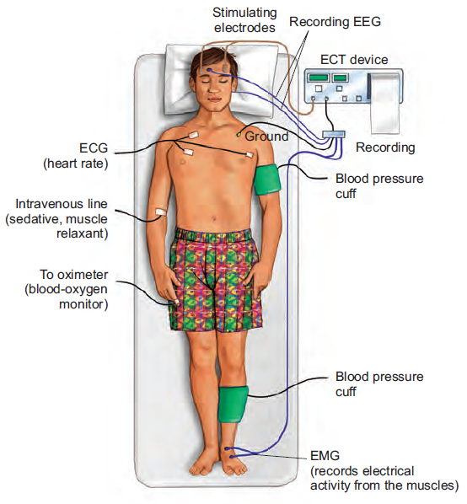
ECT

Slide 38
Repetitive Transcranial Magnetic Stimulation
Repeated pulses of magnetic energy
Uses magnetic fields, instead of electricity, and does not produce convulsions.
painless
depression and rTMS
TMS Therapy

Slide 39
Deep Stimulation
An experimental procedure which is administered by a pacemaker that controls implanted electrodes. The stimulation inhibits activity in a brain area that feeds negative emotions and thinking
Deep Brain Stimulation and Depression

Slide 40
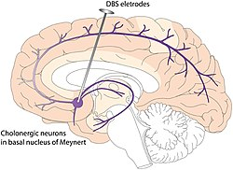

Slide 41
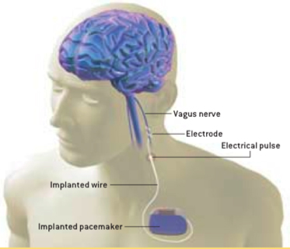
Electrical device which stimulates the vagus nerve.
  Treatment for chronic depression, epilepsy

Slide 42
Psychosurgery
Module 34: Biomedical Therapies

Slide 43
Lobotomy
A now-rare form of psychosurgery once used to try to calm uncontrollably emotional or violent patients;
the procedure cut the nerves that connect the frontal lobes of the brain to the deeper emotional centers.
Regularly done before the advent of antipsychotic drugs
Rarely used today

Slide 44
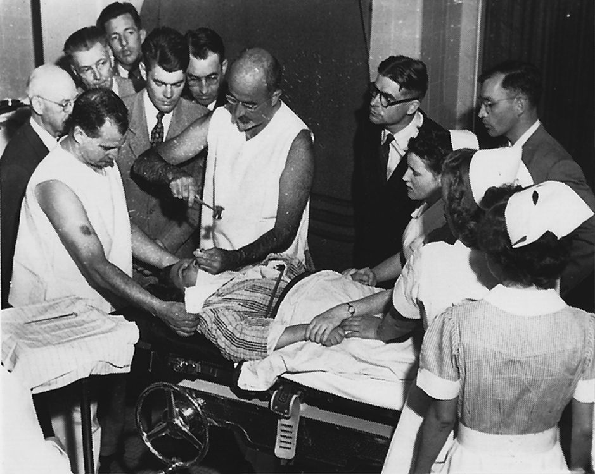
Lobotomy

Slide 45
lobotomy (10 mins)

Slide 46
Back to the stone age:
Trepanation: process of introducing holes into the skull (for treatment of epilepsy and spiritual therapy)
Cingulotomy: this procedure involves passing an electrode needle through two small holes in the skull and searing a tiny lesion in the cingulum(nerve fibers linking the emotional center to the cortex)
Phrenology: study of the structure of the skull to determine a person’s character and mental capacity

Slide 47
Other Treatments
Lifestyle changes to treat depression.
Exercise. Regular exercise can be as effective at treating depression as medication. Not only does exercise boost serotonin, endorphins, and other feel-good brain chemicals, it triggers the growth of new brain cells and connections, just like antidepressants do.

Slide 48
Social support. Strong social networks reduce isolation, a key risk factor for depression.
Nutrition. Eating well is important for both your physical and mental health. (avoid simple carbohydrates to avoid the sugar crash)
Sleep. Sleep has a strong effect on mood. When you don’t get enough sleep, your depression symptoms will be worse.

Slide 49
Stress reduction. Too much stress exacerbates depression and puts you at risk for future depression.
If lifestyle changes don’t work, see a doctor. If your depression is the result of medical causes, therapy and antidepressants will do little to help.

Slide 50
End of Module Questions:
1. Depression is one of the most common disorders in the world. Researchers and therapists are continually trying to come up with more effective, less invasive, painless methods of helping people find relief. Discuss the timeline of biomedical therapy when it comes to depression. How was it dealt with, how is it dealt with and what may the future hold for this often debilitating illness?
2. Family members often dropped their loved ones off at mental hospitals in the past. It seemed cruel and cold to do so. Imagine you were living in those times. What would be the positives and negatives of doing such a thing? Can you imagine doing this? Discuss.
3. Very few mental institutions still exist. Is there a need for a place for those who cannot function on their own? Should we bring them back? Discuss.
4. Discuss your view on antidepressant use in our society. (overuse, necessary?, placebo, money, etc)

Slide 51
The End

Slide 52
Teacher Information
Types of Files
  This presentation has been saved as a “basic” Powerpoint file. While this file format placed a few limitations on the presentation, it insured the file would be compatible with the many versions of Powerpoint teachers use. To add functionality to the presentation, teachers may want to save the file for their specific version of Powerpoint.
Animation
  Once again, to insure compatibility with all versions of Powerpoint, none of the slides are animated. To increase student interest, it is suggested teachers animate the slides wherever possible.
Adding slides to this presentation
  Teachers are encouraged to adapt this presentation to their personal teaching style. To help keep a sense of continuity, blank slides which can be copied and pasted to a specific location in the presentation follow this “Teacher Information” section.

Slide 53
Teacher Information
Domain Coding
  Just as the textbook is organized around the APA National Standards, these Powerpoints are coded to those same standards. Included at the top of almost every slide is a small stripe, color coded to the APA National Standards.
    Scientific Inquiry Domain
    Biopsychology Domain
    Development and Learning Domain
    Social Context Domain
    Cognition Domain
    Individual Variation Domain
    Applications of Psychological Science Domain
Key Terms and Definitions in Red
  To emphasize their importance, all key terms from the text and their definitions are printed in red. To maintain consistency, the definitions on the Powerpoint slides are identical to those in the textbook.

Slide 54
Teacher Information
Hyperlink Slides - Immediately after the unit title slide, a page (usually slide #4 or #5) can be found listing all of the module’s subsections. While in slide show mode, clicking on any of these hyperlinks will take the user directly to the beginning of that subsection. This allows teachers quick access to each subsection.
Continuity slides - Throughout this presentations there are slides, usually of graphics or tables, that build on one another. These are included for three purposes.
    By presenting information in small chunks, students will find it easier to process and remember the concepts.
    By continually changing slides, students will stay interested in the presentation.
    To facilitate class discussion and critical thinking. Students should be encouraged to think about “what might come next” in the series of slides.
Please feel free to contact me at korek@germantown.k12.wi.us with any questions, concerns, suggestions, etc. regarding these presentations.
  Kent Korek
  Germantown High School
  Germantown, WI 53022

Slide 55
Name of Concept
Use this slide to add a concept to the presentation

Slide 56
Name of Concept
Use this slide to add a table, chart, clip art, picture, diagram, or video clip. Delete this box when finished

